Slide 1
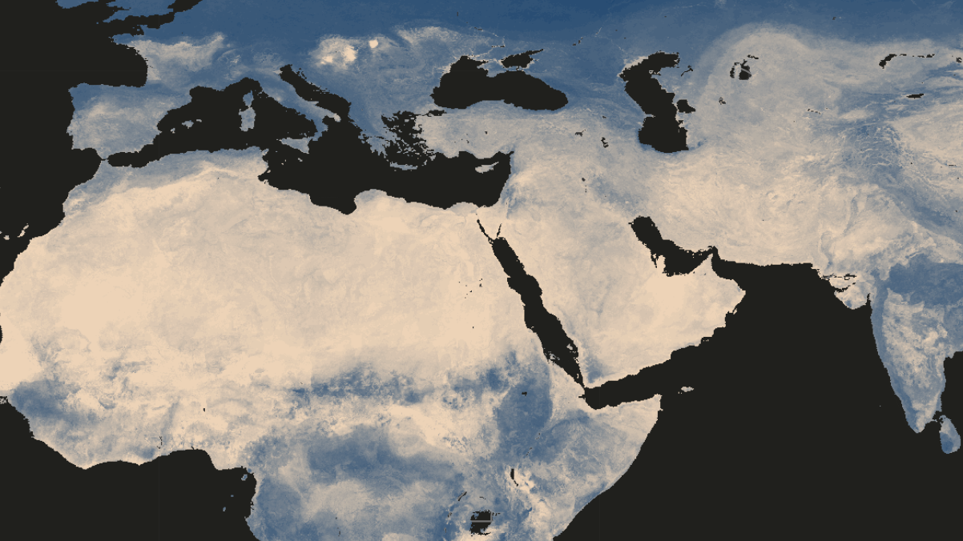
Soil Data Challenge 2025

Slide 2
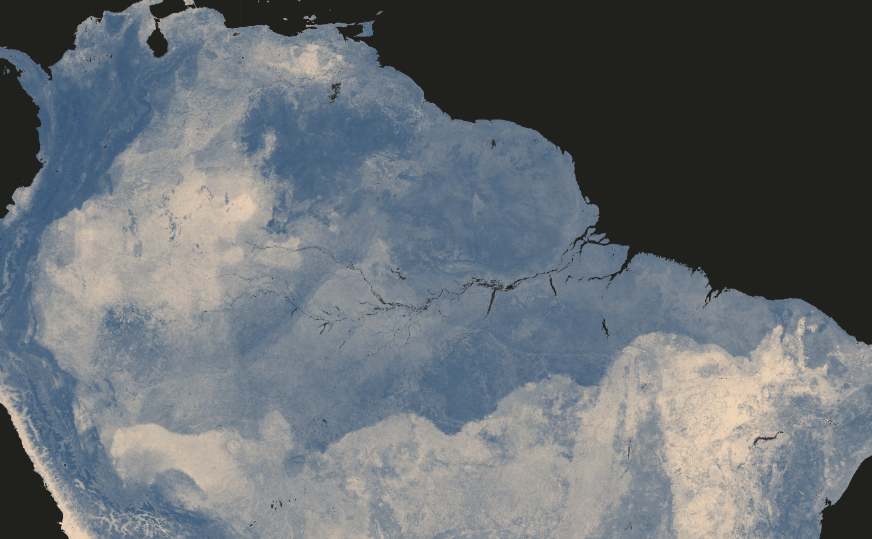
The challenge
A freely-chosen task on soil data
Curiosity (whatever topic)

Slide 3
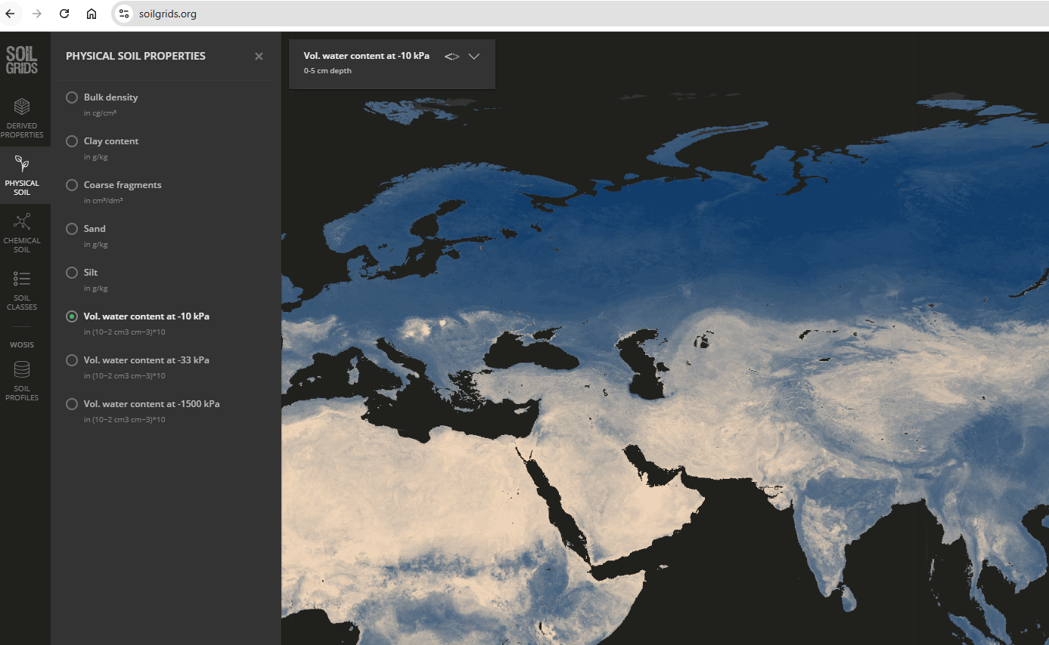
The data
https://soilgrids.org/

Slide 4
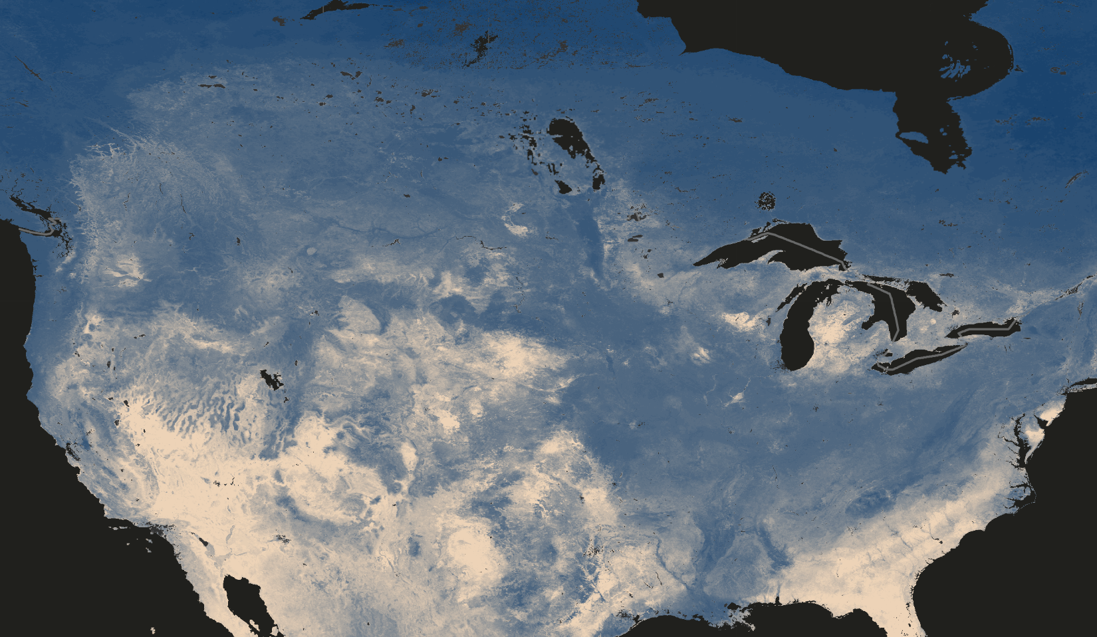
The task
Exploring the data platform
Brain-storming and targeting one question
Downloading and analyzing the data
Reporting

Slide 5
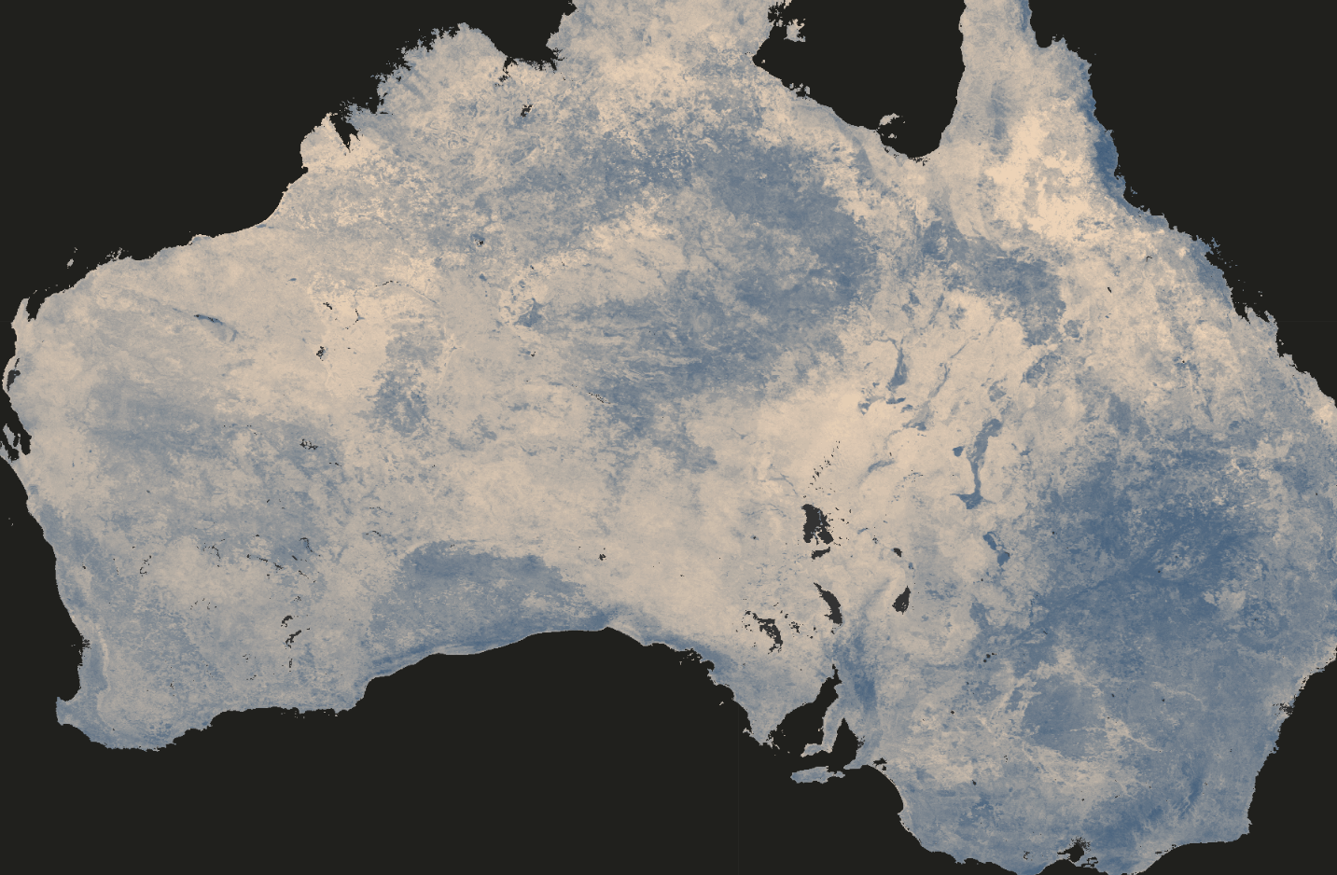
The award
Bonus point of 0.25 ~ 0.5 in the final grade of the Computer lab

Slide 6
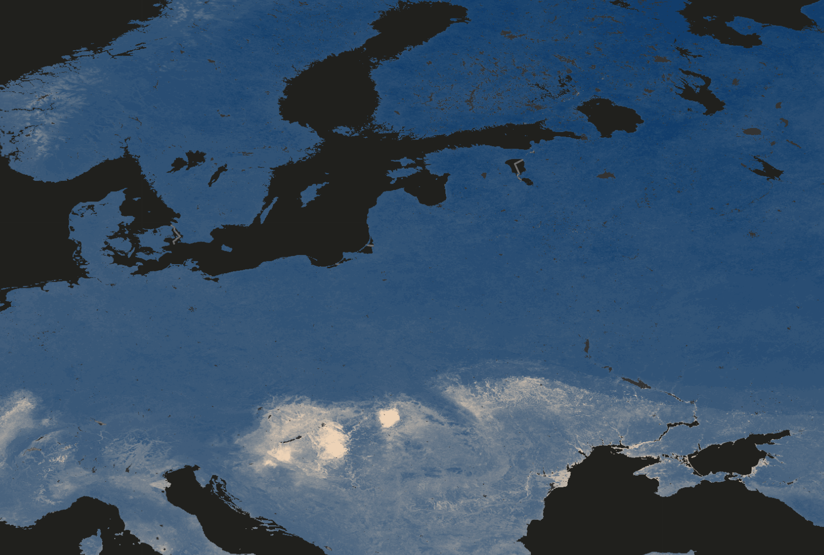
The requirement
Using soil data from https://soilgrids.org/
  You can apply the models from the previous assignments but also free to just analyze whatever interests you
Reporting (~2 page), same structure as before
  Describing clearly why you are curious about this question (Introduction), what data and methods you use (Methods), what results you get (Results), what you think (Discussion), and Conclusion
Working in group (everyone has to contribute)
Expected working time: 5~10 hours
Free to use AI for coding but not for research questions

